Slide 1

LAB#04
Artificial Intelligence
Abdul Haseeb

Slide 2
Lab Objectives
Pandas Library
Numpy Library

Slide 3
Numpy Library
In Python we have lists that serve the purpose of array
But being heterogenous these are slow to process
Numpy provides an array object that is 50x faster in processing than the lists:
Array object is called ndarray

Slide 4
Numpy Objectives
Creating Numpy arrays
Array Operations
Array Manipulations
Advanced Topics

Slide 5
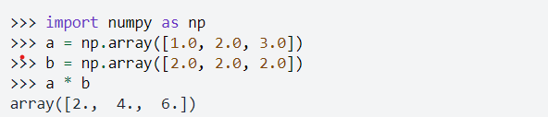
Broadcasting
Numpy allows operations on arrays of different shapes with certain constraints

Slide 6
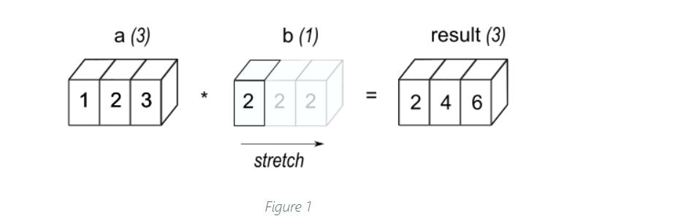

Slide 7
Data Analysis
Process of analyzing large data sets to get answers to questions related to that data set
Pandas Module in python allows us to do data analysis easily

Slide 8
Data Munging/Wrangling
Process of cleaning messy data (Polishing), for example filling in the missing values, refilling the noisy values

Slide 9
Pandas Objectives
Data Frame Basics
Different ways of creating Data Frame
Handling Missing Values
GroupBy

Slide 10
Tasks
Taks 01: Get all those rows from the dataframe where temperature is even and windspeed is odd
Task 02: Get all those rows from the dataframe where windspeed is lesser than the mean of the windspeed column
Taks 03: Get all those records when event is either snow or rain and temperature is above 25

Slide 11
Tasks
Section 1: Data Exploration
Load the dataset into a pandas DataFrame.
Display the first 5 rows of the dataset.
Check for missing values
Get the summary statistics (mean, std, min, max) for each column.
Section 2: Data Filtering
Filter wines with quality rating > 7.2.
Filter wines with alcohol content > 13%.
Filter wines with pH < 3.5.

